Slide 2

When one of the workers is stopped

Slide 3
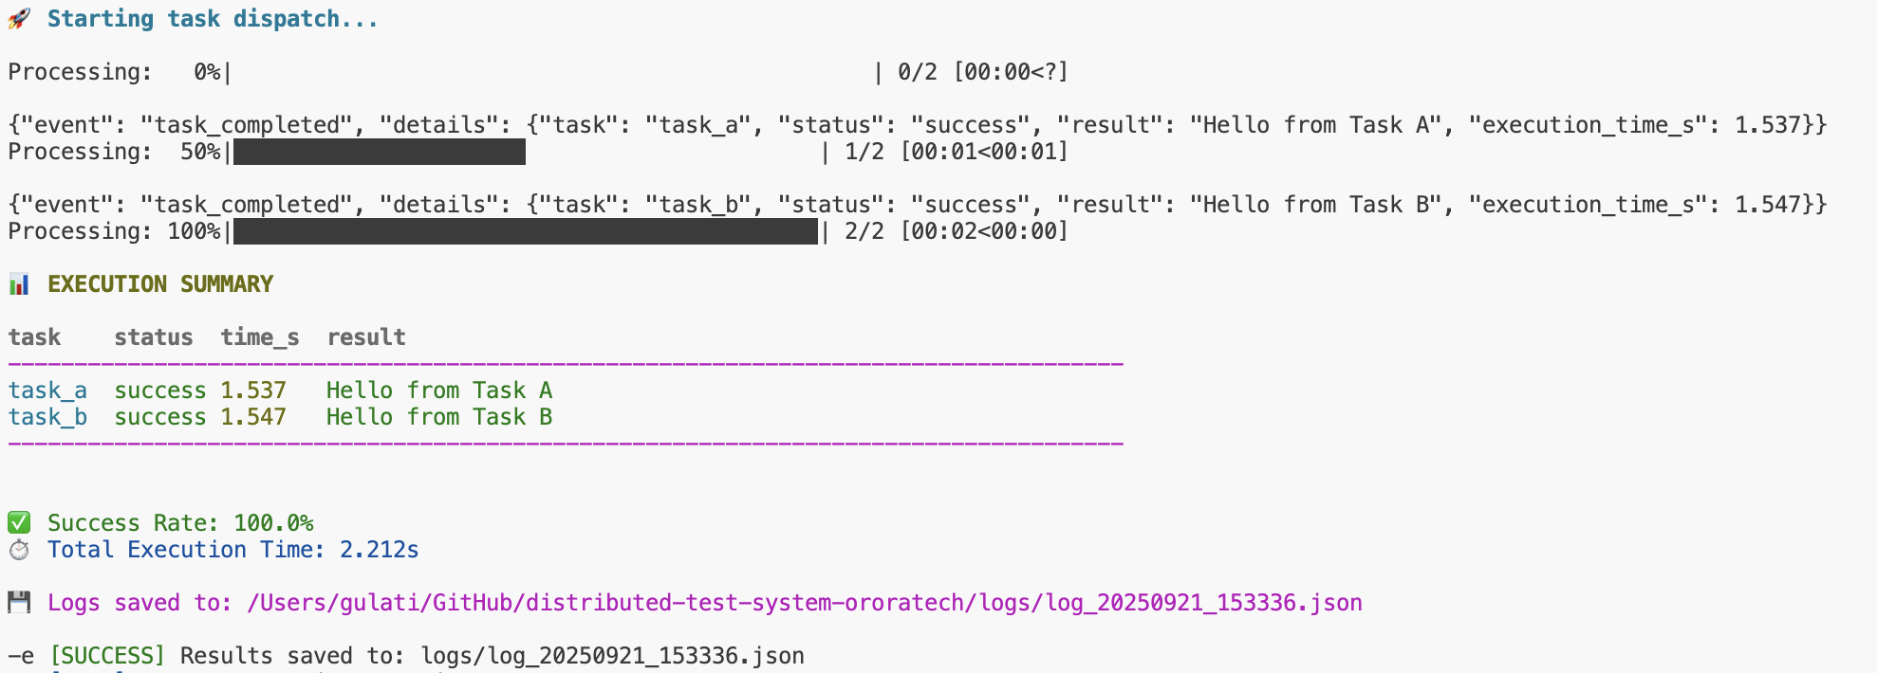
If time per task >1s

Slide 4
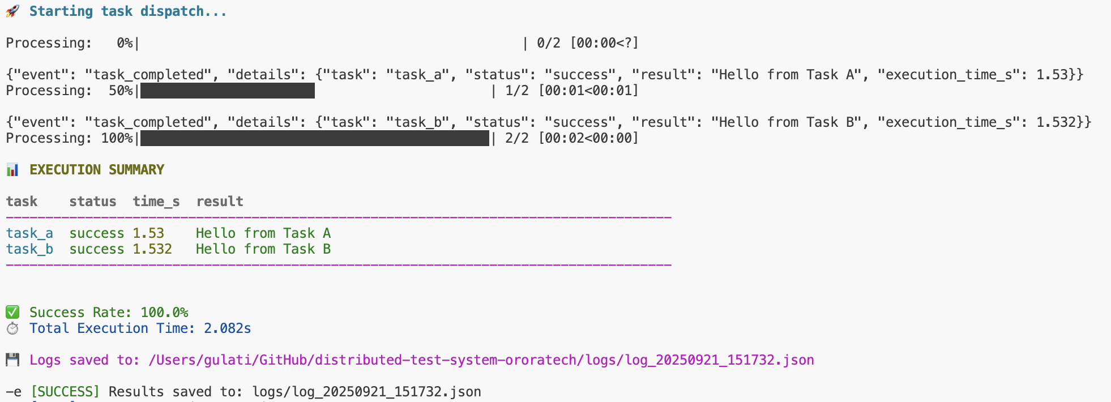
When all workers are working

Slide 5

When no workers are working

